Slide 1
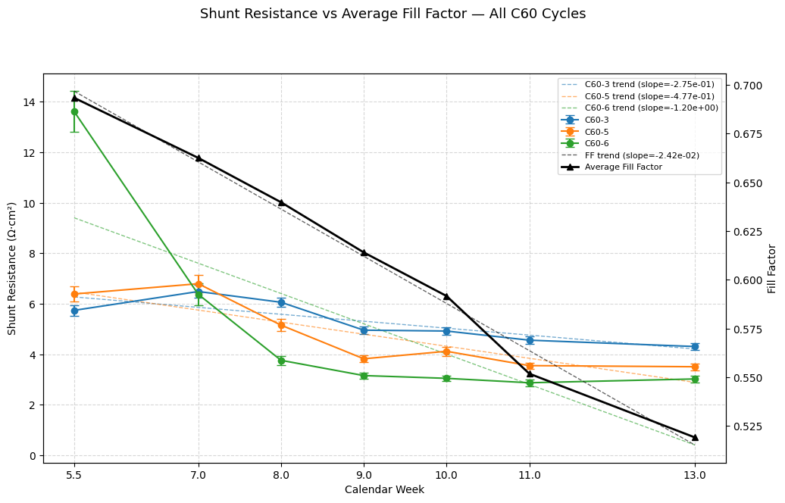

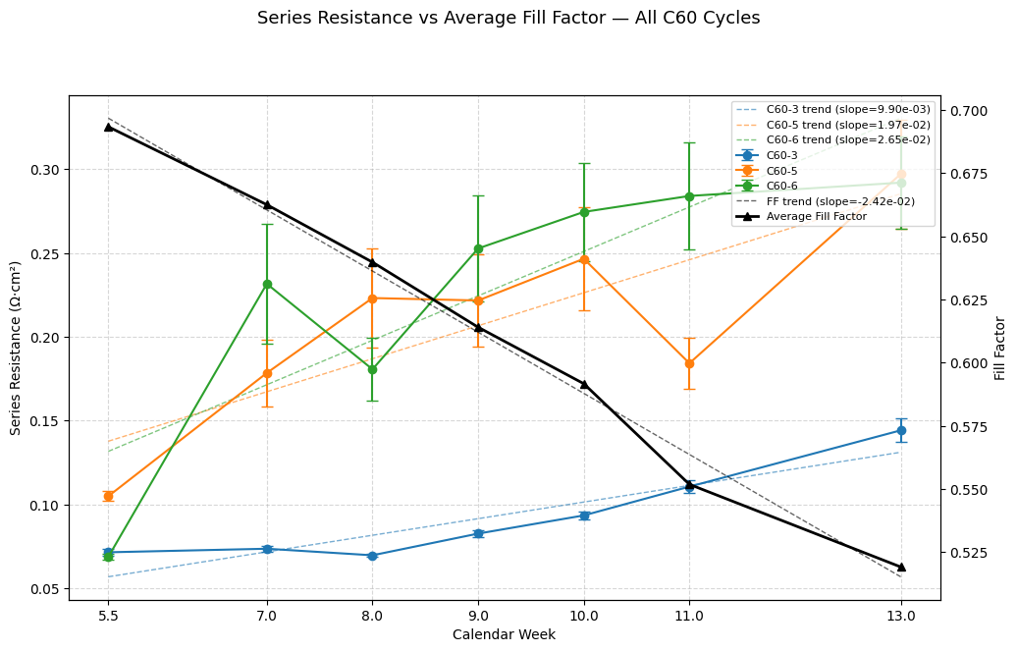
Project Question: Shunt and Series Resistance against FF
Overview:
Analyzed resistance trends across all cells using a multi-variable linear regression (MLR) model
Compared results to Fill Factor (FF) to show and interpret correlations
Findings:
Fill factor decreased at a faster rate for cells with 5 and 6 C60 cycles.
Series resistance of the cells with 5 and 6 C60 cycles has a moderate impact on cell efficiency using MLR.
Series resistance has a minimal impact for C60 3.
A different model is likely needed to explain degradation rates.
Overall: Series resistance shows a moderate correlation with FF degradation for C60 5 & 6 with MLR, no significant influence for 3 C60.

